Slide 1
Online Web Store
By: Suyash Adhikary, Liya Norng, Cameron Tanjoco

Slide 2
Technologies used to further are project
Bootstrap
Java
JSP
MySQL
CSS
HTML5
Glassfish Server

Slide 3
Because we need more online webstores…
We created an online webstore that handles user information where the user can – buy online goods, create their own profile, and have their data saved on a database.

Slide 4
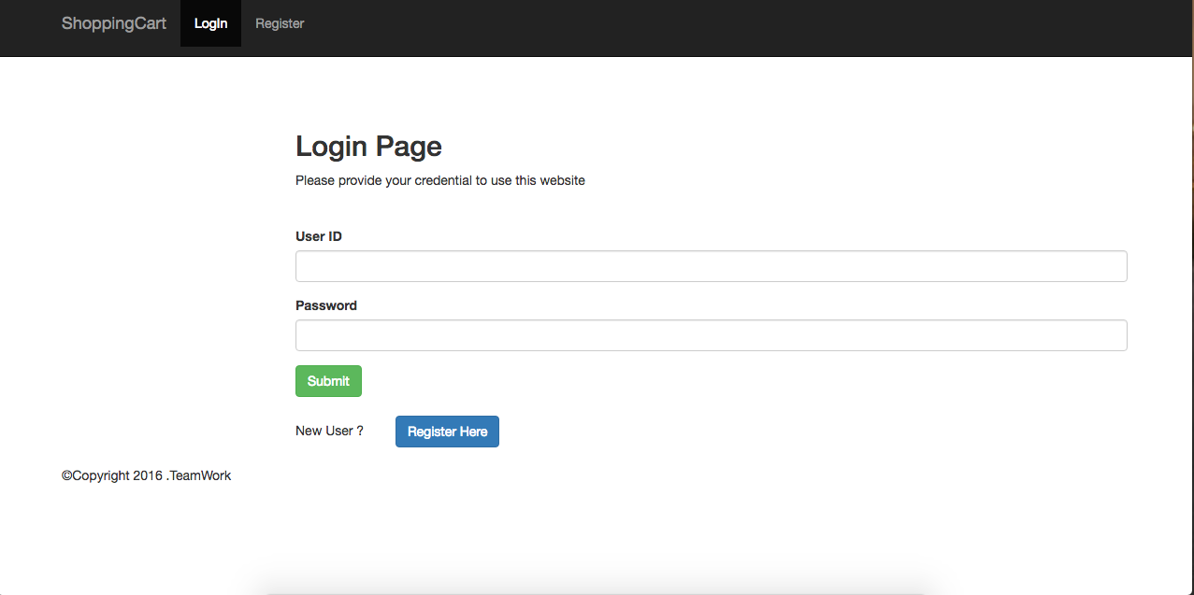

Slide 5
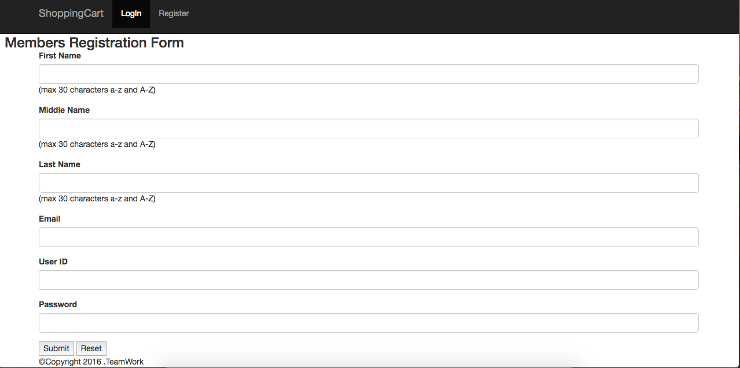

Slide 6
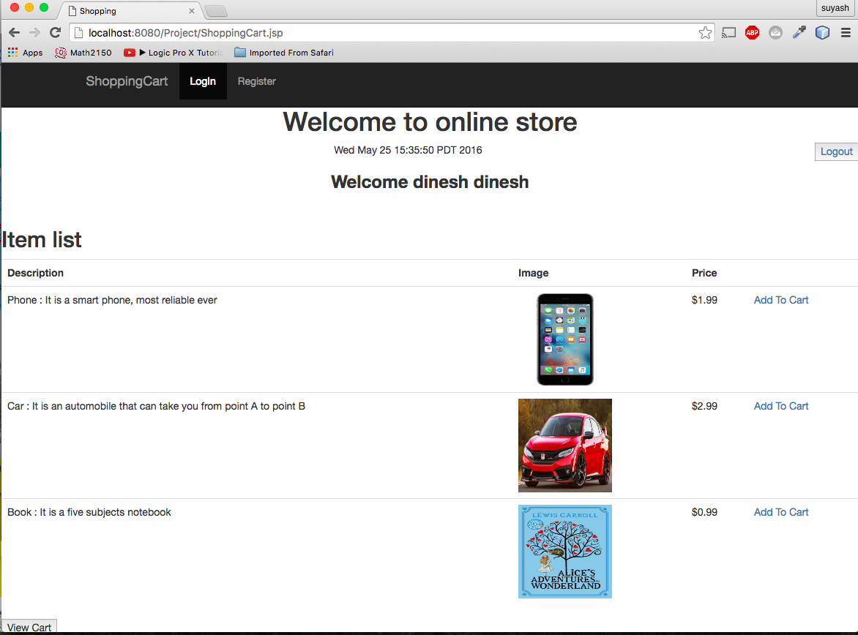
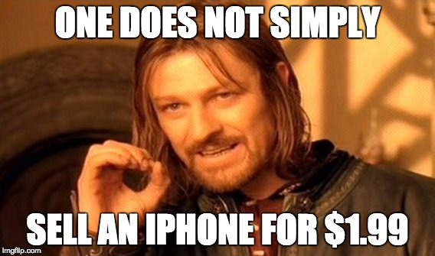

Slide 7
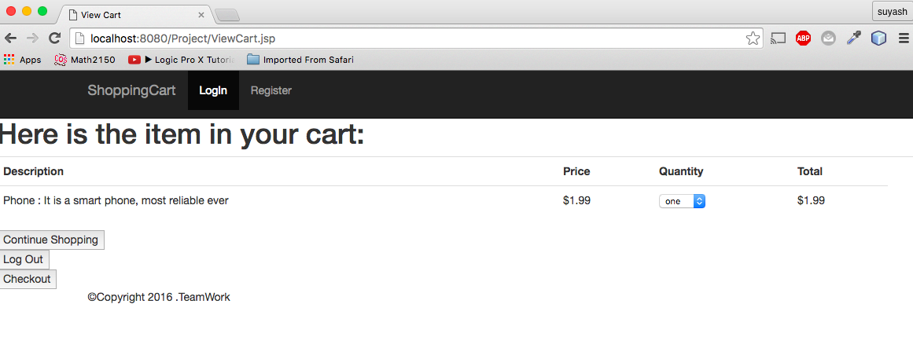

Slide 8
Difficulties
Connecting to database.
Tried to use the Hibernate class, however, it didn’t work so we used the conventional way

